Slide 1
Audit and Analysis for Effective Digital Presence
BY:
SRIMATHI K

Slide 2
Problem Statement
Analyze the website of a company to evaluate its digital presence.
Audit the website based on design, user experience, and SEO performance.
Identify areas where the website can be improved for better engagement and visibility.
Recommend digital marketing strategies to enhance online performance.
Design a sample landing page to improve lead generation and brand awareness.

Slide 3
Company Overview
DXC Technology
About the Company
Global IT services and consulting company providing technology-driven business solutions.
Founded in 2017 through the merger of Computer Sciences Corporation (CSC) and Hewlett Packard Enterprise’s Enterprise Services division.
Headquarters located in Ashburn, Virginia, United States.
Operates in 70+ countries and serves enterprise and public sector clients worldwide.
Workforce of over 120,000 professionals delivering IT and digital transformation services.

Slide 4
Company Overview
Core Services
Cloud computing and cloud transformation solutions
Cybersecurity services
Data analytics and artificial intelligence solutions
IT outsourcing and infrastructure management
Application modernization and digital engineering
Digital Presence
Official website: https://dxc.com
The website showcases services, industry solutions, case studies, and insights.
Serves as the company’s primary platform for communicating its technology capabilities and engaging with global clients.

Slide 5
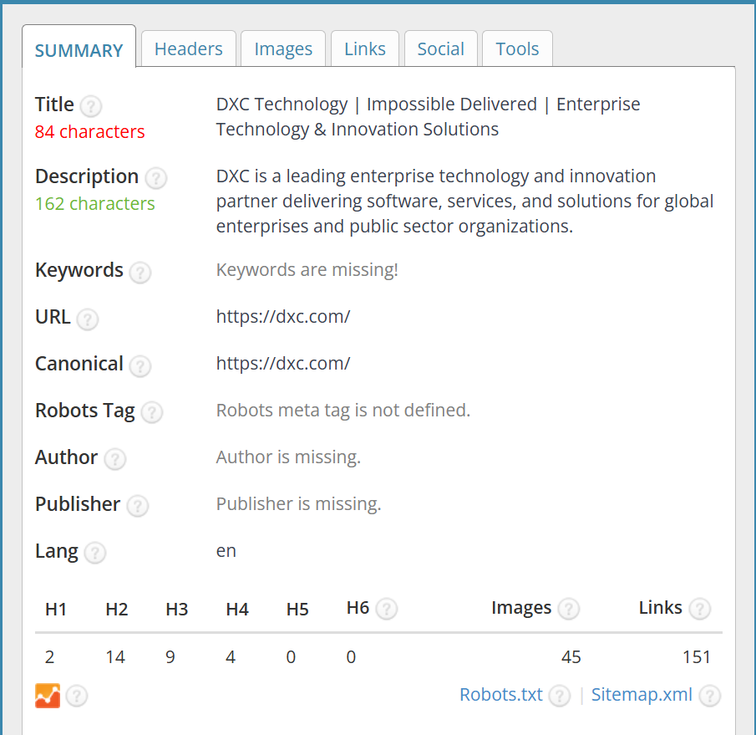
SEO Metadata Analysis
Tool Used: SEO Meta in 1 Click
Page Title
Indicates the main topic of the webpage and appears in search engine results.
The title length is 84 characters, which is slightly longer than the recommended SEO range.
Meta Description
A short summary of the webpage displayed in search results.
The DXC website includes a 162-character meta description clearly describing the company’s services.

Slide 6
SEO Metadata Analysis
Heading Structure (H1, H2, H3)
Headings organize web page content and help both users and search engines understand page structure.
The website uses multiple headings (H1, H2, H3), indicating a structured content hierarchy.
Images
Images improve visual engagement and user experience.
The webpage contains 47 images, which enhance presentation but should include optimized ALT text for SEO.
Internal Links
Internal links connect pages within the website and help search engines crawl the site.
The DXC homepage contains 151 links, supporting navigation and content accessibility.

Slide 7
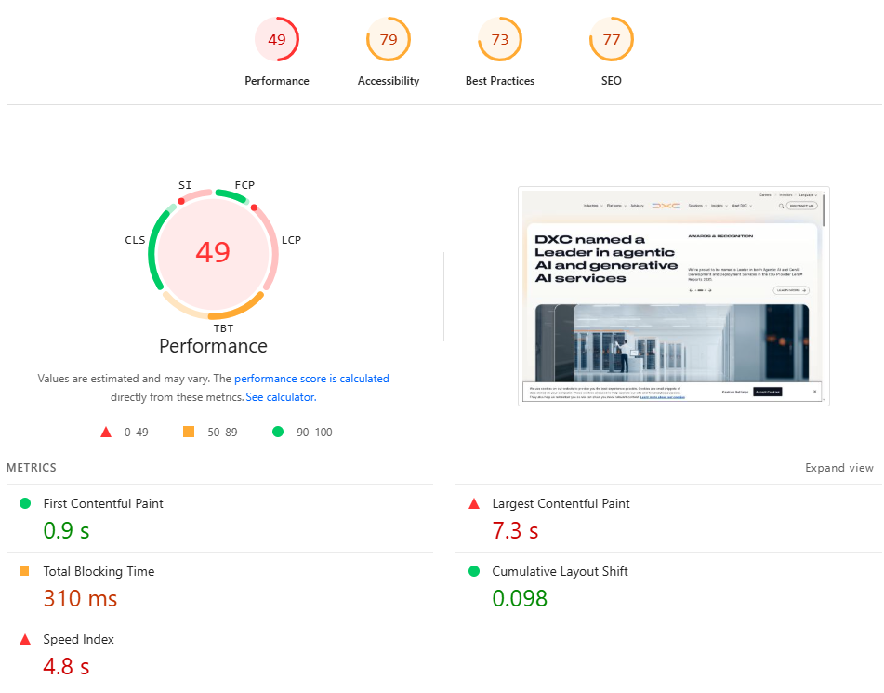
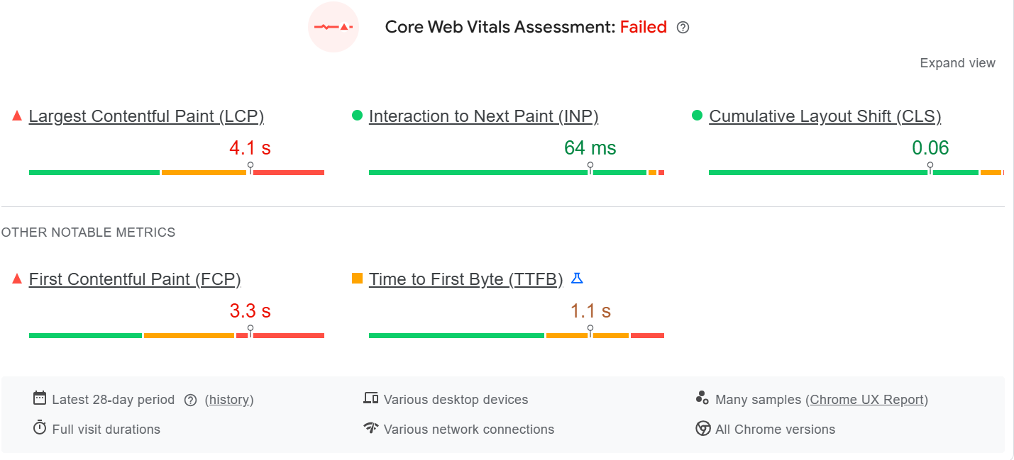
Page Speed Audit
Overall Scores
Performance: 49 – Page loading speed is relatively slow. Accessibility: 79 – Mostly accessible but some usability improvements needed. Best Practices: 73 – Some technical optimizations recommended. SEO: 77 – Good SEO structure with room for improvement.
Core Web Vitals
LCP: 4.1s – Main content loads slower than recommended. INP: 64 ms – Good responsiveness to user interactions. CLS: 0.06 – Stable layout with minimal visual shifts.

Slide 8
Page Speed Audit
Additional Metrics
FCP: 3.3s – First visual content appears slightly slowly.
TTFB: 1.1s – Moderate server response time.
Speed Index: 4.8s – Overall page content loads moderately slow.
Key Insights
The website has good interaction responsiveness and layout stability.
However, page loading speed is relatively slow, affecting overall performance score.
Performance could improve through image optimization, script reduction, and better resource loading strategies.

Slide 9

Mobile Responsiveness Analysis
Tool Used: Responsive Design Checker
Website layout adapts effectively to mobile screen sizes.
Content sections stack vertically, improving readability on smaller devices.
Images and banners resize properly without breaking the layout.
Navigation menu is simplified for easier mobile interaction.
Observation
The website provides a mobile-friendly design, ensuring a smooth browsing experience across different devices.

Slide 10
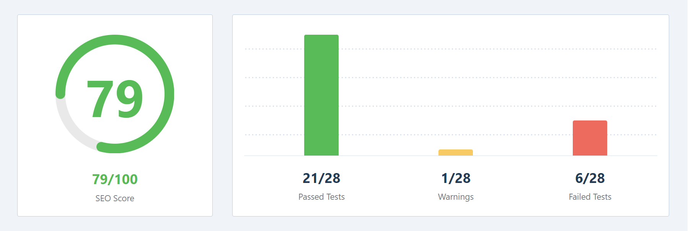
SEO Audit Analysis
Key Issues Identified (Tool Used: RankMath SEO Analyzer)
Multiple H1 tags detected on the page (recommended: one H1 per page).
Some images lack ALT attributes, affecting accessibility and image SEO.
Title length exceeds recommended SEO limit, which may get truncated in search results.
Schema structured data not detected, limiting enhanced search results.
Some JavaScript files not fully optimized, which may affect performance.
Observation:
The website demonstrates a strong SEO foundation, supported by a good SEO score and proper technical setup.
The presence of HTTPS, sitemap, and robots.txt helps improve security and search engine indexing.
Regularly updated content supports better search relevance and ranking.
Further improvements in technical SEO elements such as image ALT text, heading structure, and structured data could enhance overall search visibility.

Slide 11
Digital Marketing Strategy
Shift Awareness → Search (SEO)
Optimize service pages for high-intent keywords (cloud migration, cybersecurity, AI services). Implement schema markup to improve rich results and CTR.
Thought Leadership → Content Marketing
Convert whitepapers/events into SEO blogs, case studies, and webinars. Use pillar pages + topic clusters to grow organic traffic.
Events & Sales Outreach → Landing Pages
Create service-specific landing pages with clear CTAs (Book Demo / Talk to an Expert). Add lead capture forms and downloadable assets.
Branding → Social & B2B Channels
Scale LinkedIn campaigns targeting enterprise decision-makers. Share insights, reports, and success stories to build authority.
Lead Capture → Marketing Automation
Use email nurturing and CRM integration to qualify leads. Track performance with conversion analytics and campaign ROI.

Slide 12
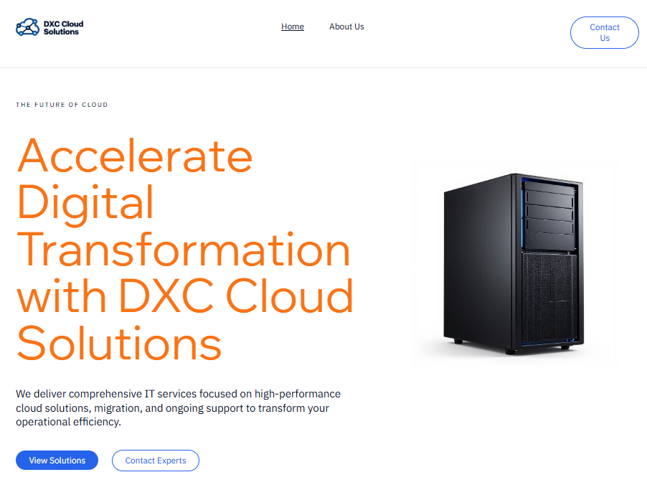
WEBSITE DESIGN
URL: https://lavendersugar21.wixsite.com/dxc-cloud-solutions
Tool Used: Wix
A landing page for DXC Cloud Solutions was designed to demonstrate website structure, service offerings, and lead generation strategies.
The page includes a hero section, service highlights, value proposition, expert team section, and a contact call-to-action to encourage potential clients to request cloud consultation services.

